Slide 1
Spark Internals
Data Engineering - Spark
Faculty Name: Anandh Kumar M

Slide 2
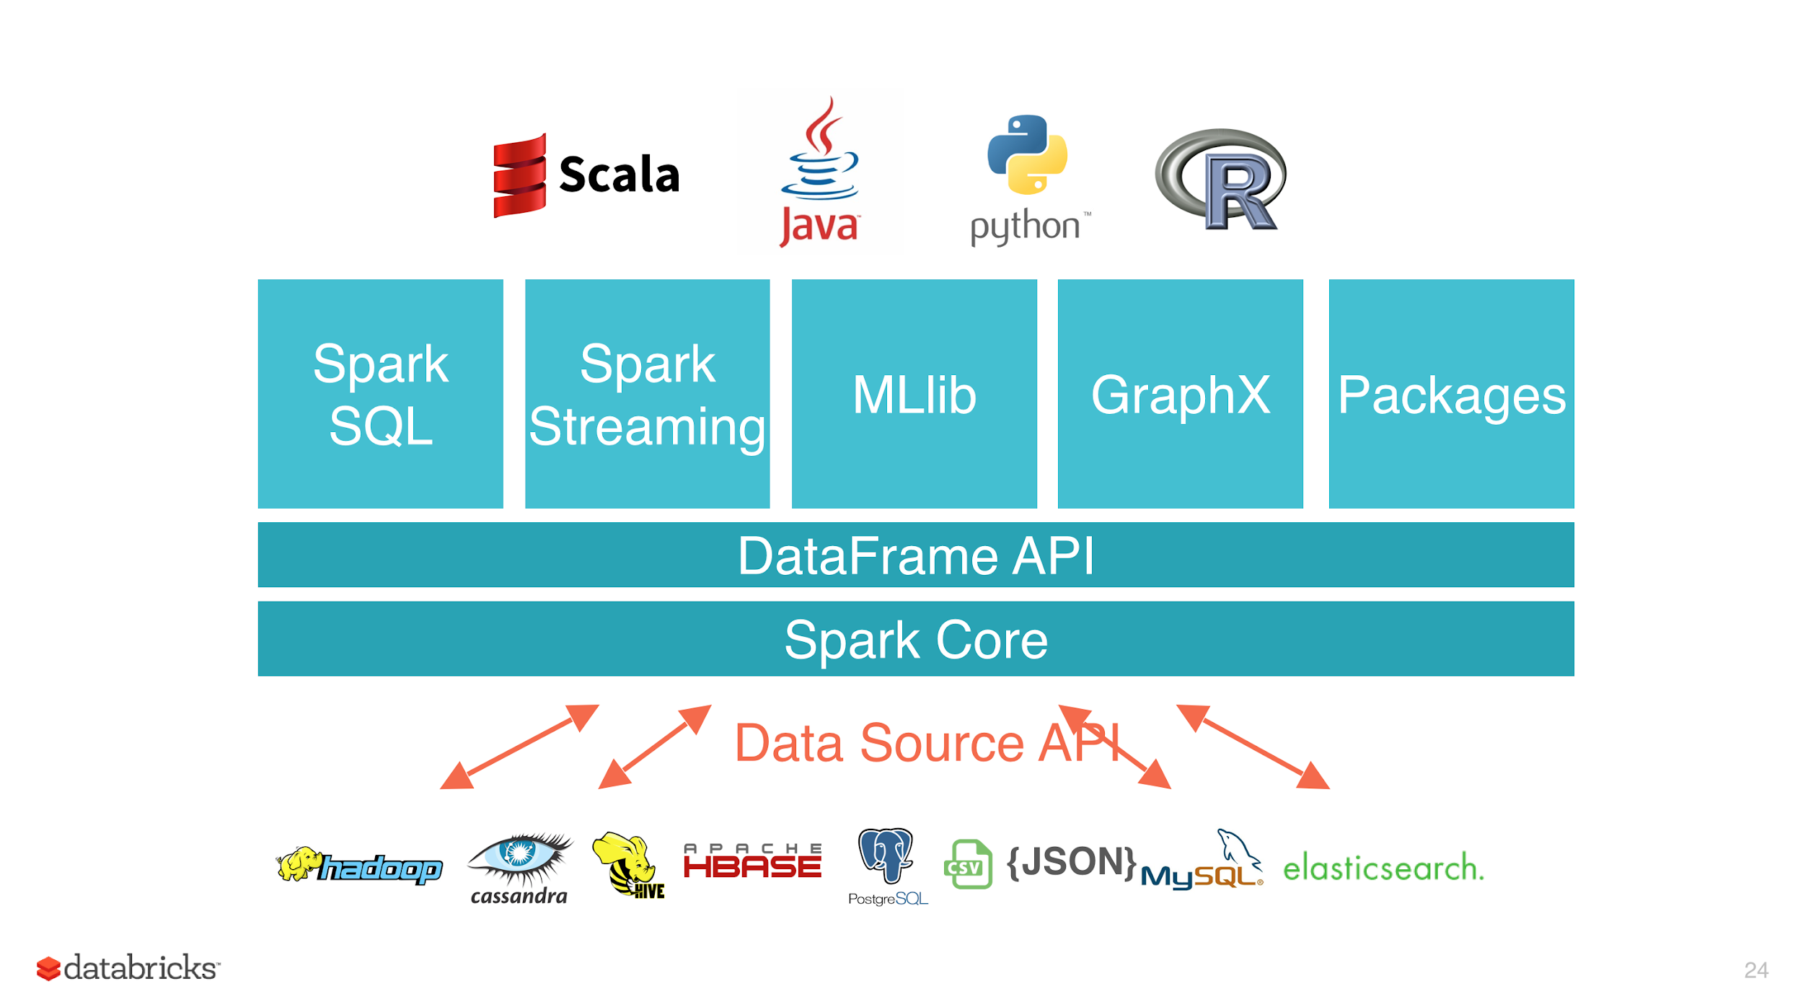

Slide 3
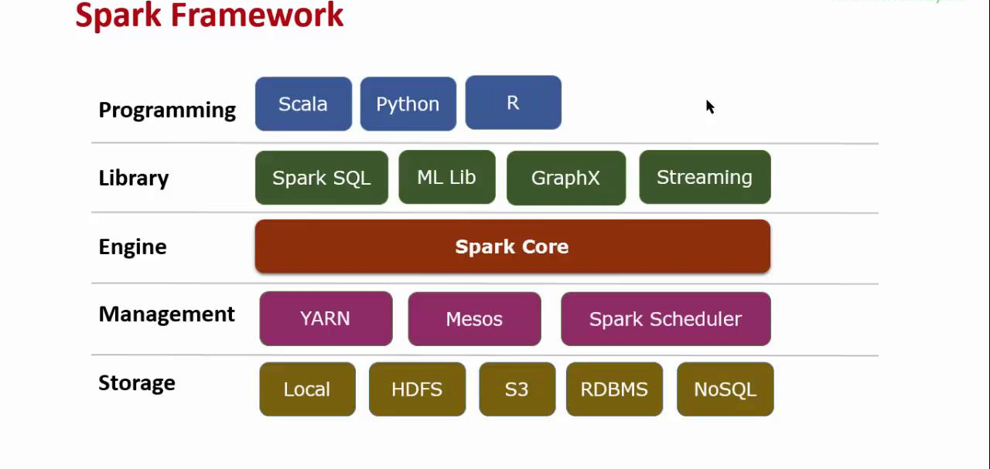

Slide 4
Components of spark
Job: A piece of code which reads some input from HDFS or local, performs some computation on the data and writes some output data.
Stages: Jobs are divided into stages. Stages are classified as a Map or reduce stages (Its easier to understand if you have worked on Hadoop and want to correlate). Stages are divided based on computational boundaries, all computations (operators) cannot be Updated in a single Stage. It happens over many stages.
Tasks: Each stage has some tasks, one task per partition. One task is executed on one partition of data on one executor (machine).
DAG: DAG stands for Directed Acyclic Graph, in the present context its a DAG of operators.
Executor: The process responsible for executing a task.
Driver: The program/process responsible for running the Job over the Spark Engine
Master: The machine on which the Driver program runs
Slave: The machine on which the Executor program runs

Slide 5
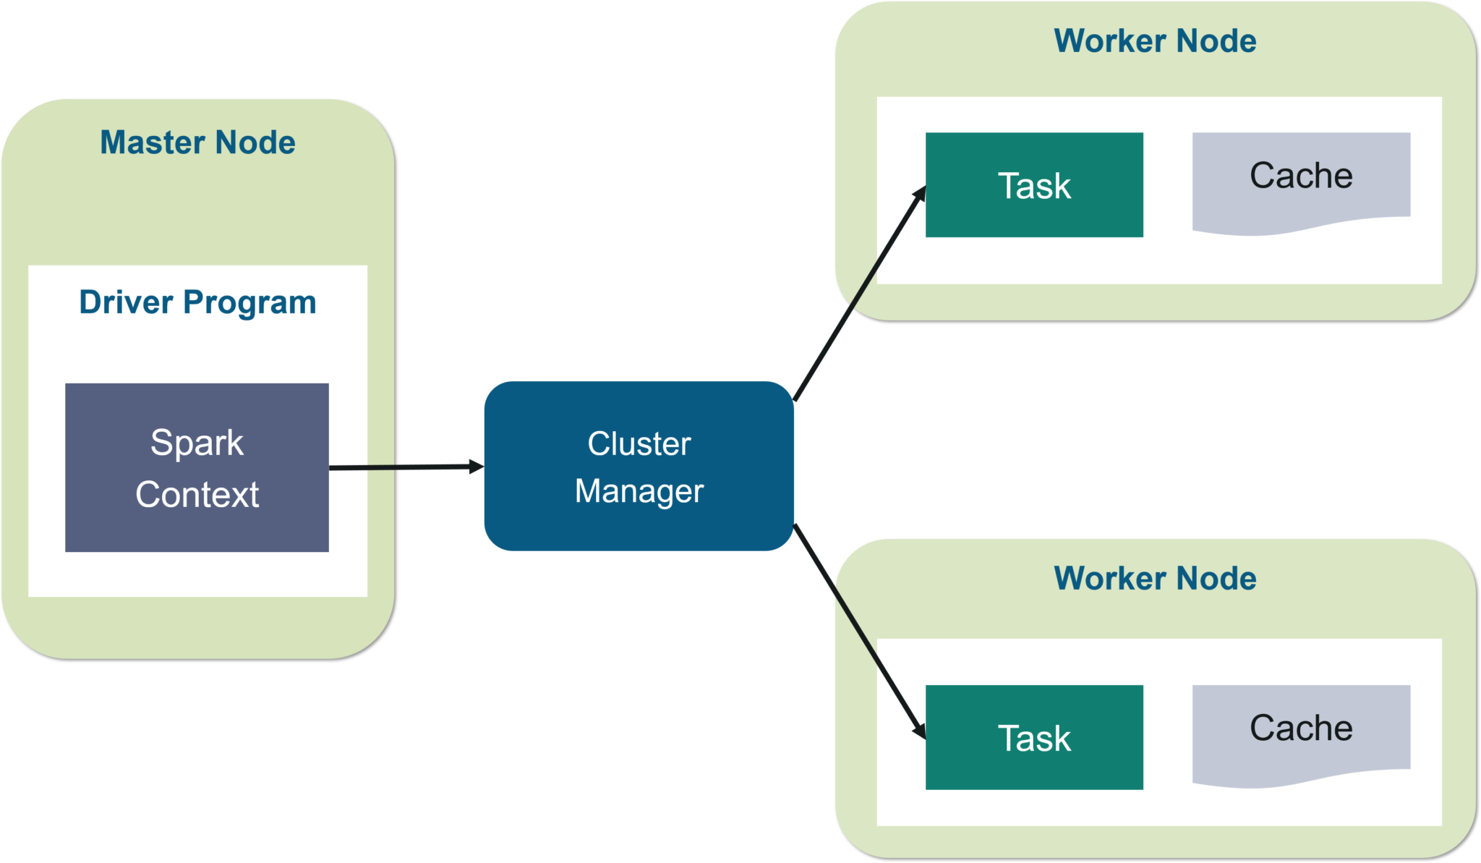

Slide 6


Slide 7
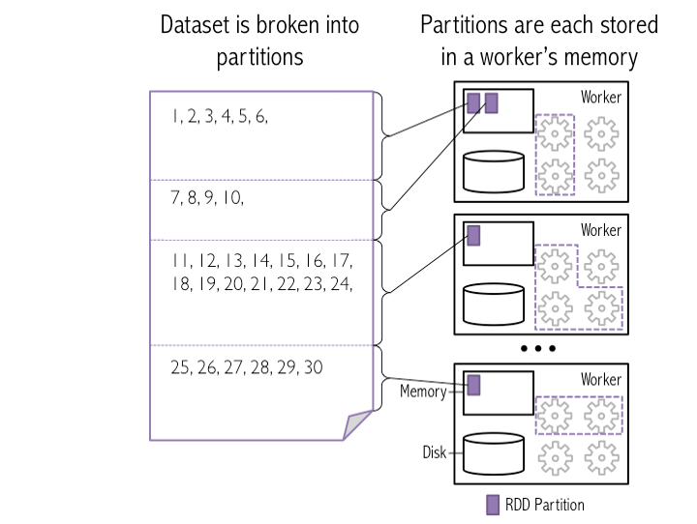

Slide 8
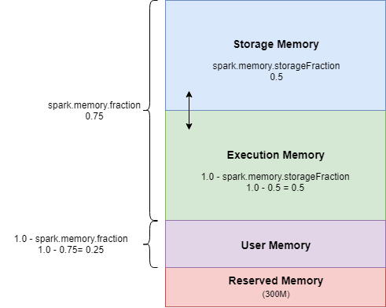
Spark Execution and Storage memory

Slide 9
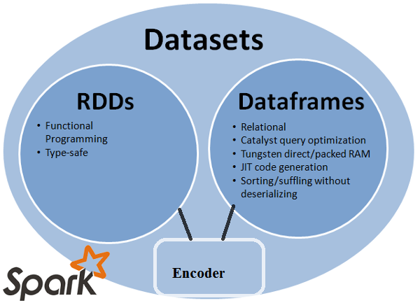

Slide 10
Memory management

Slide 11
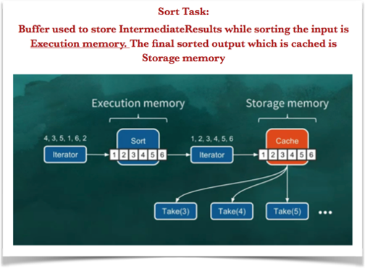
Static Memory

Slide 12
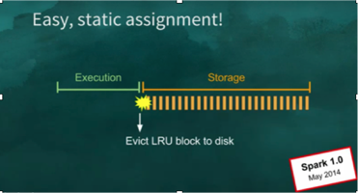
Static Memory Allocation

Slide 13
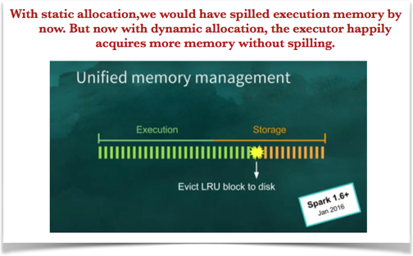
Dynamic Memory Allocation

Slide 14
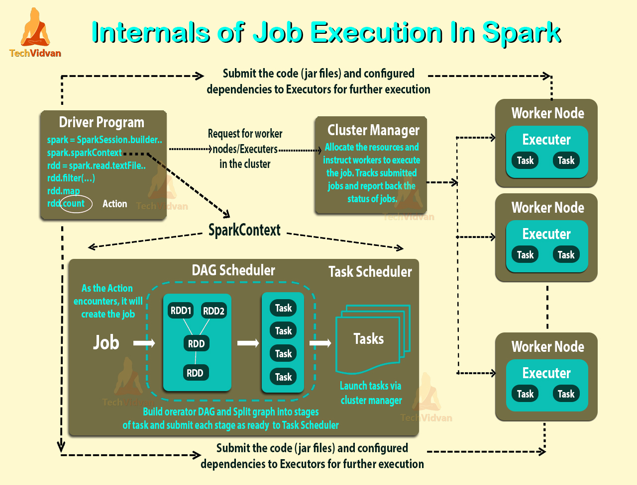

Slide 15
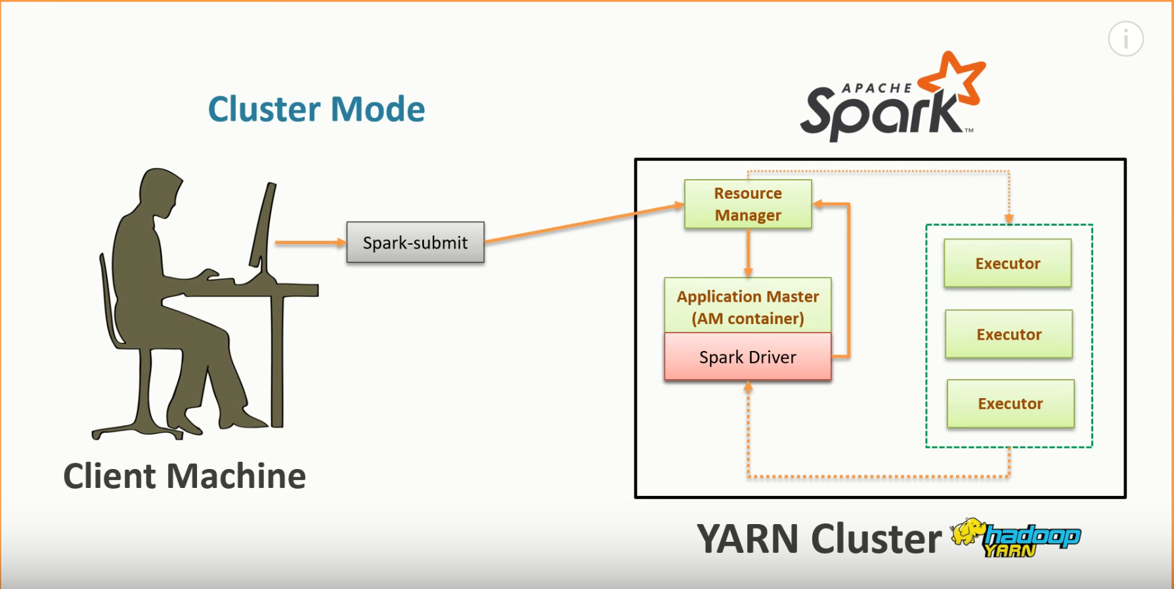

Slide 16
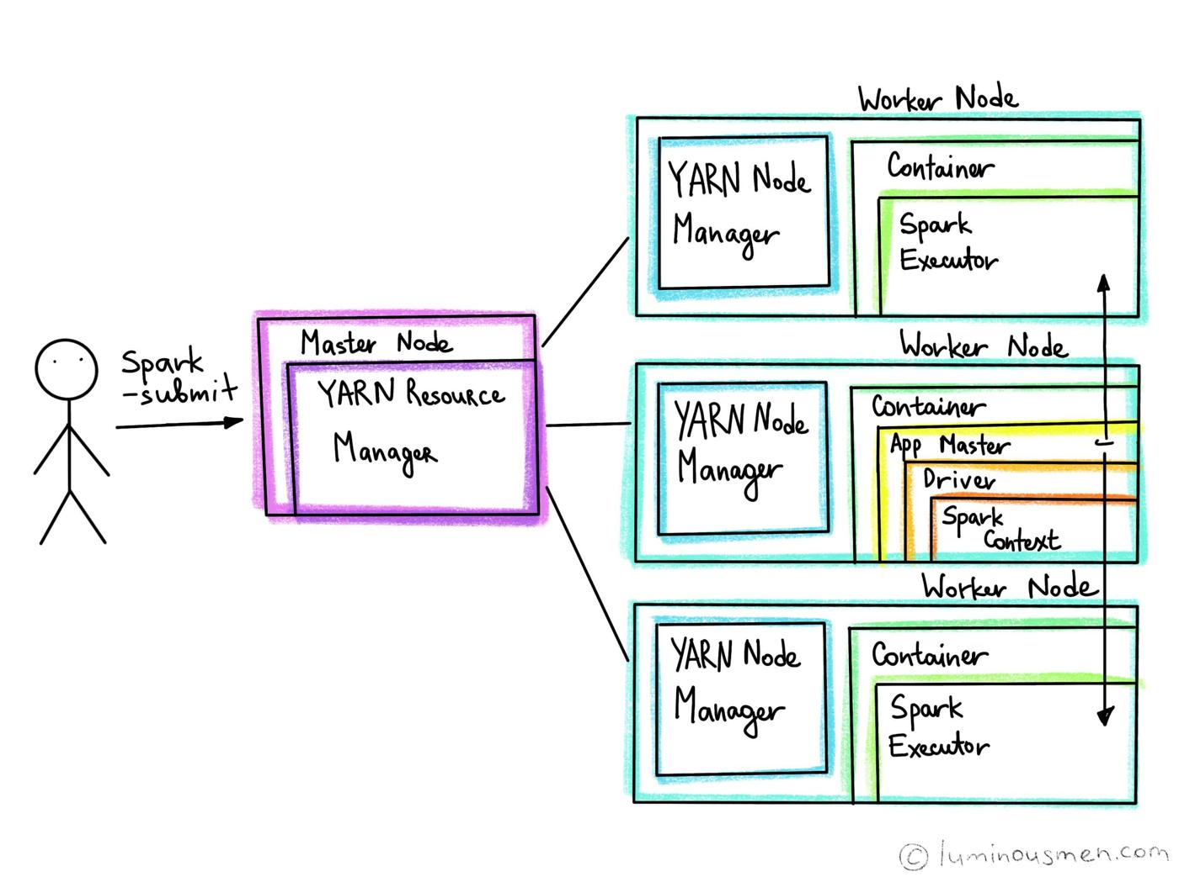

Slide 17
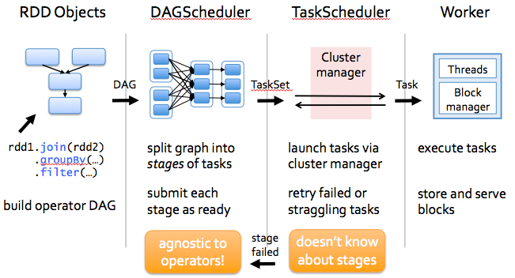

Slide 18
Spark Query plan

Slide 19
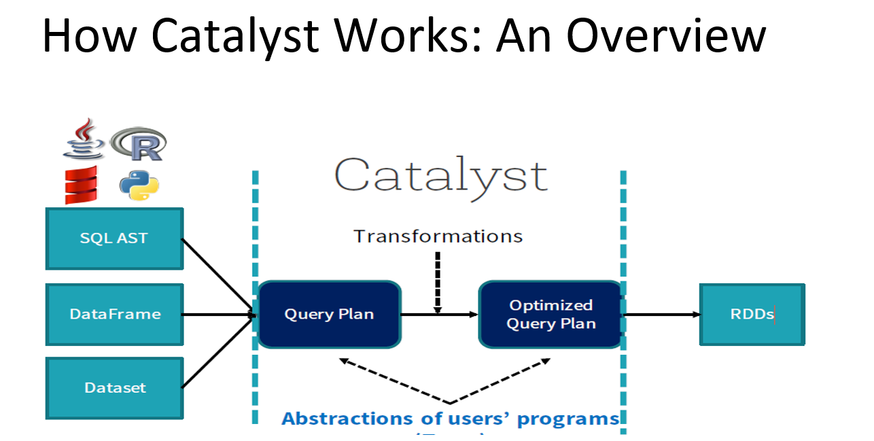

Slide 20
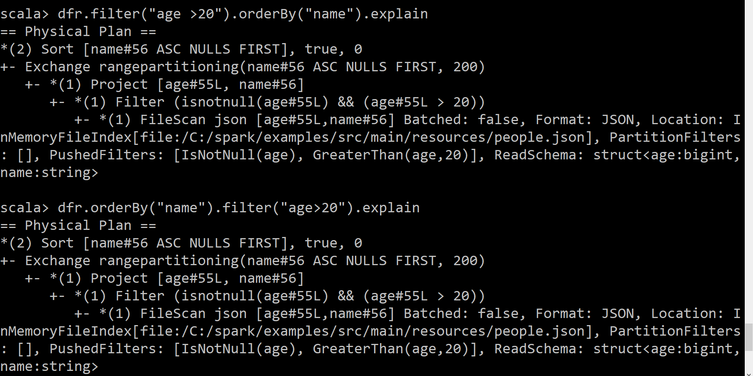

Slide 21
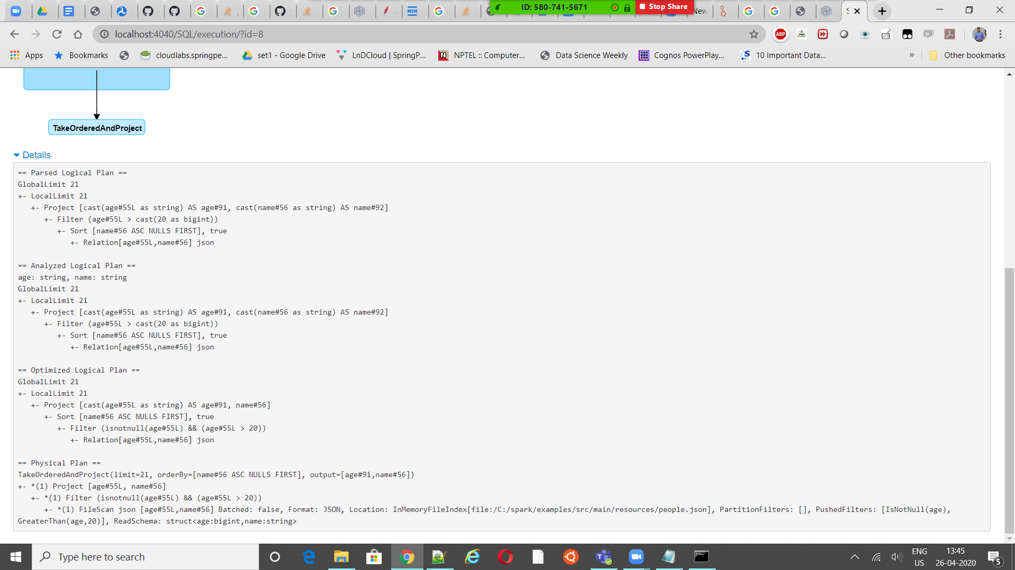

Slide 22
Memory Management
Reserved Memory =300 mb
Executor memory = 1.5 * Reserved Memory
Memory Pool =(“Java Heap” – “Reserved Memory”) * (1.0 – spark.memory.fraction)
Spark shell required memory = (Driver Memory + 384 MB) + (Number of executors * (Executor memory + 384 MB))

Slide 23
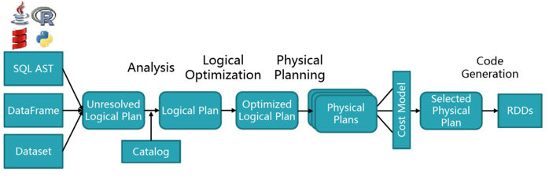
Query plan

Slide 24
Join Optimization

Slide 25
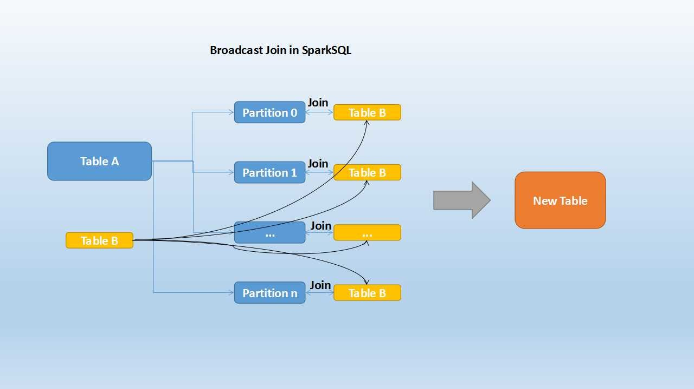
Broadcast Join

Slide 26
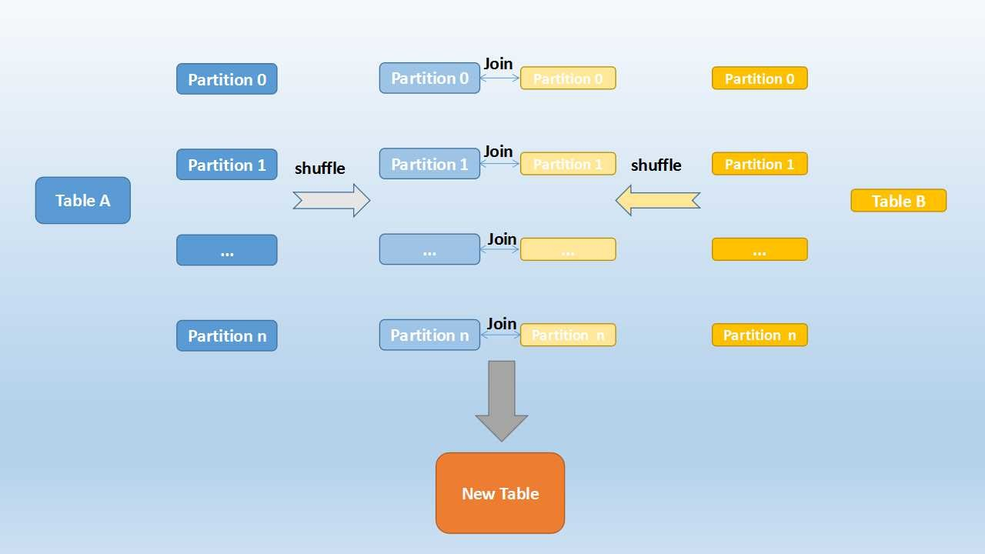
Shuffle Hash Join

Slide 27
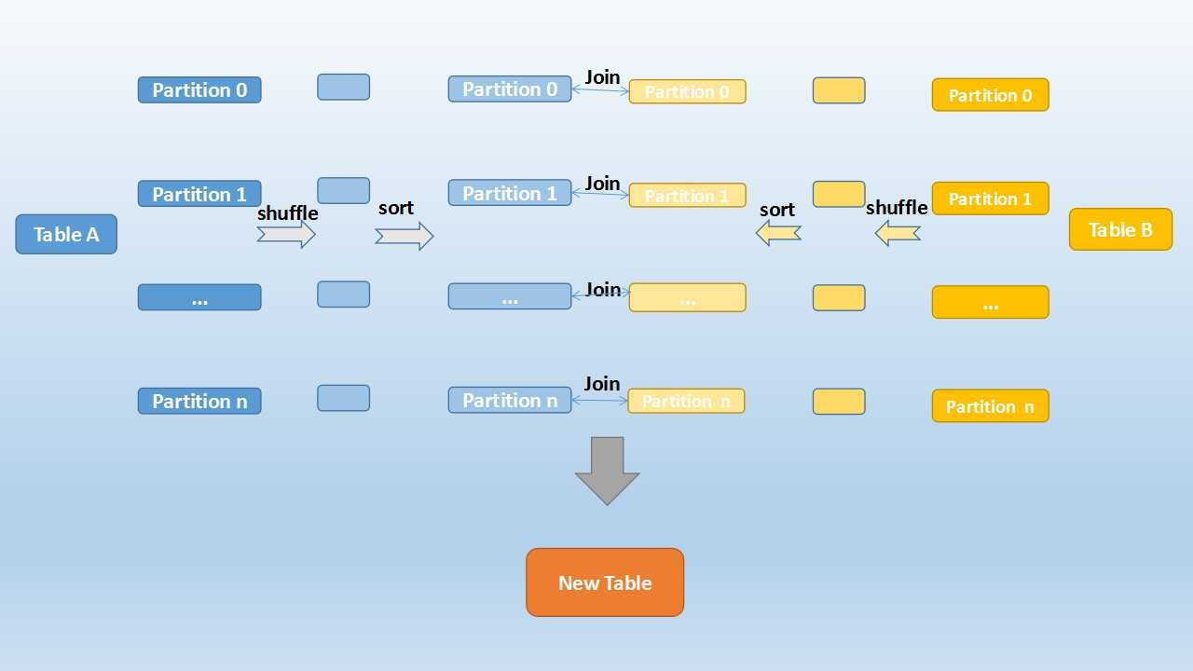
Sort Merge Join

Slide 28
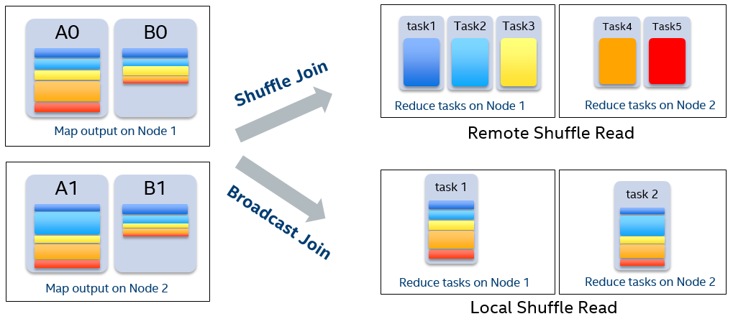

Slide 29
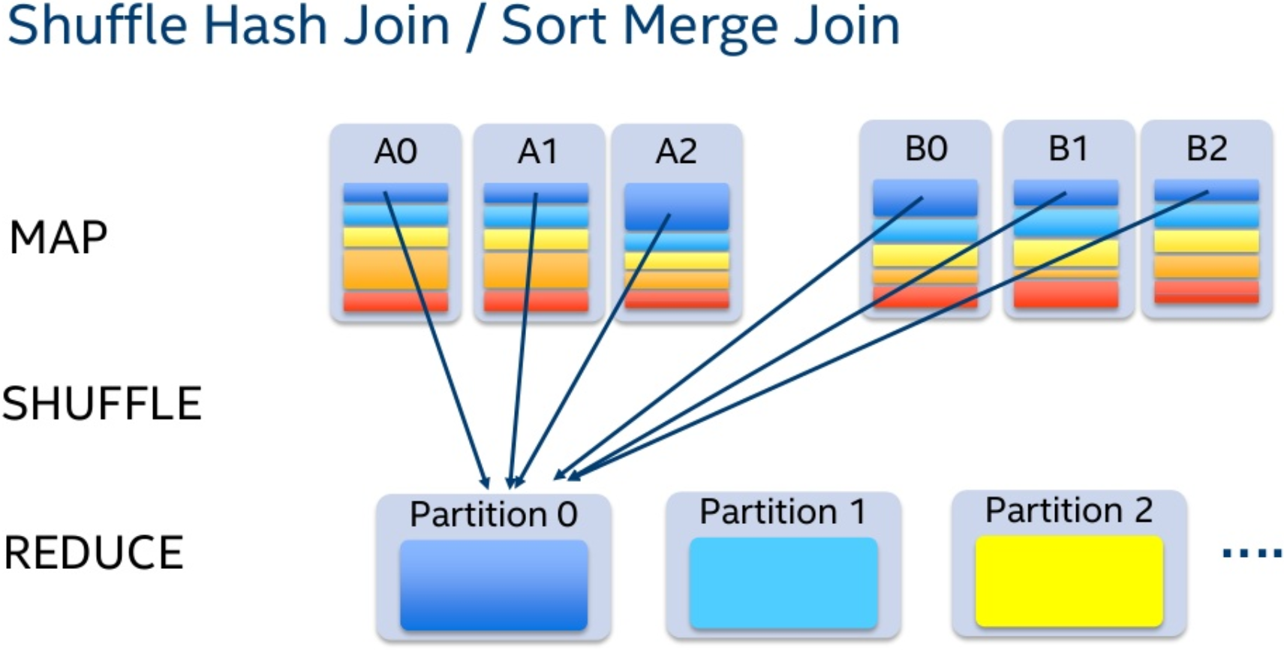

Slide 30
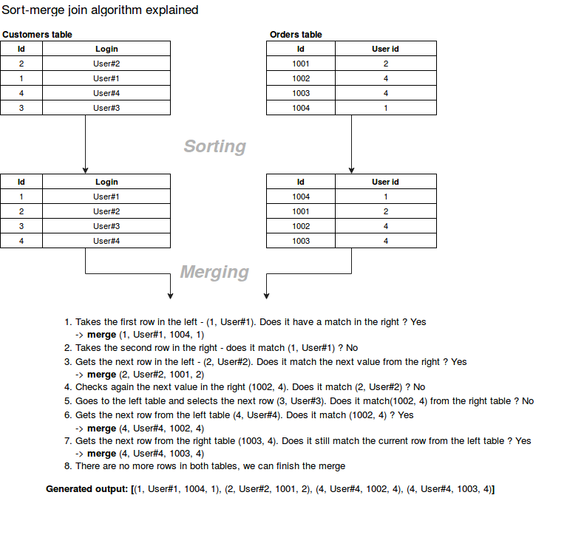

Slide 31
Spark

